Slide 1
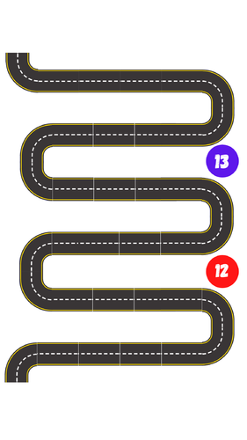
Year 12 and 13 Personal Development and Life skills
Recognising and avoiding burn out
Aesthetics and the beauty industry
Sexual harassment in the work place
Planning a Holiday
Risks and consequences
Managing pressures and influences
Date rape and sexual assault
Mortgages and renting
Body image and the media
UCAS and personal statements
Interview preparation
Types of cancers
Micro aggressions and use of language
Preparing for uni open days
Online dating and personal safety
Dangers of Vaping
Sexual Health
Gas Lighting and Emotional Abuse
Creating a LinkedIn profile
Your working Rights in Sixth form
Money, savings and debt
Tax
Positive V Toxic cultures
Thriving at KS5
New Drivers
Including Guest speakers/ Outside agencies on the following topics: Sex and contraception, The United Nations, University preparation, Driving awareness, interview skills, financial education, Thriving in sixth form, applying for university and LBTQ plus.

